Slide 1
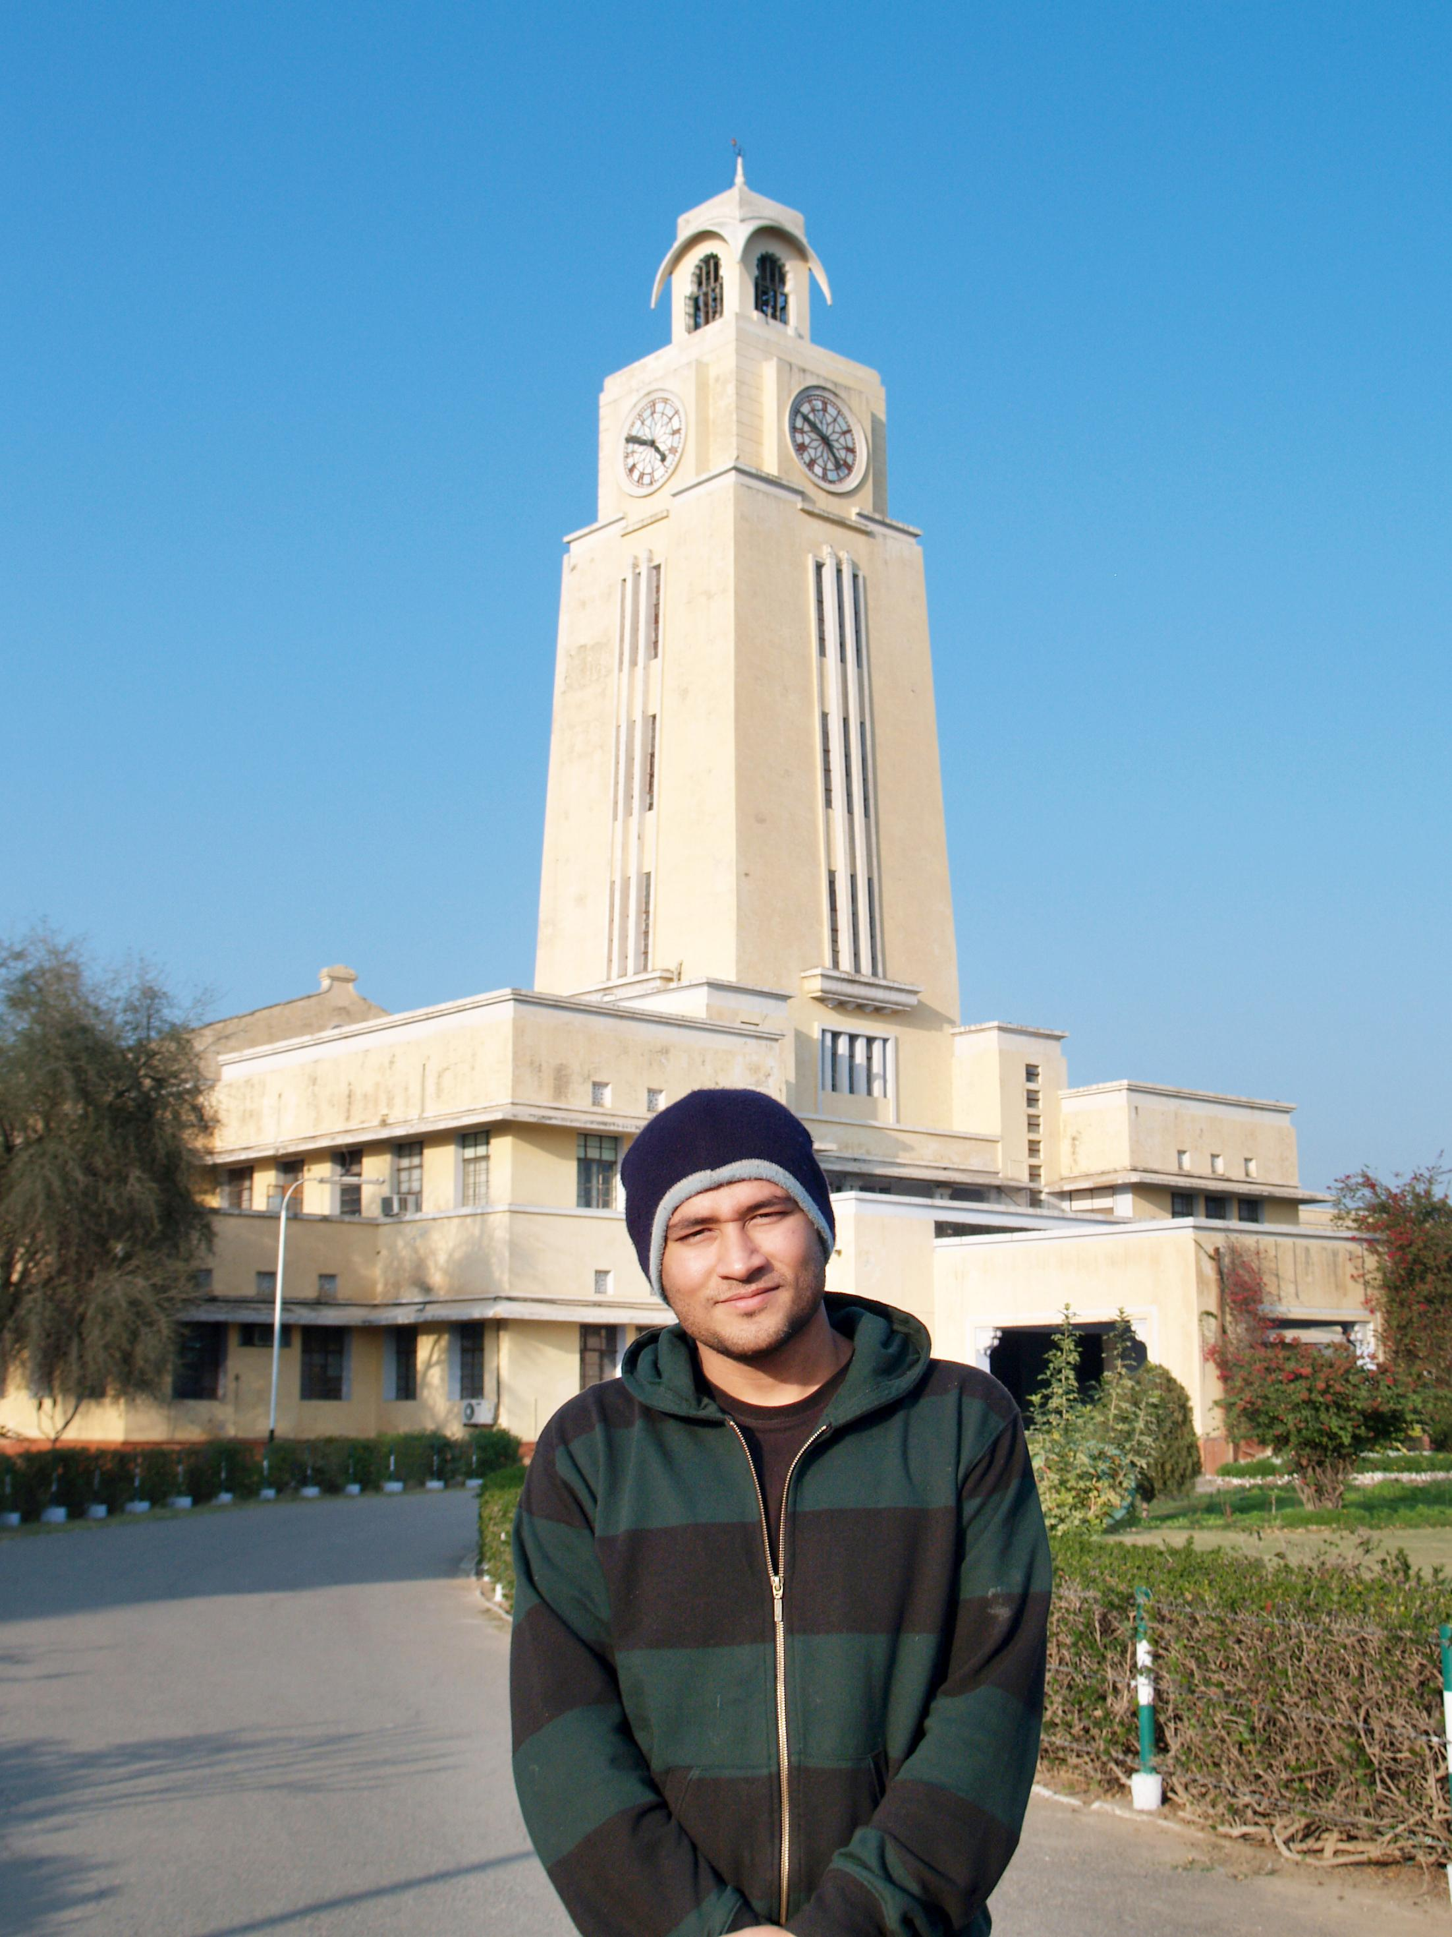

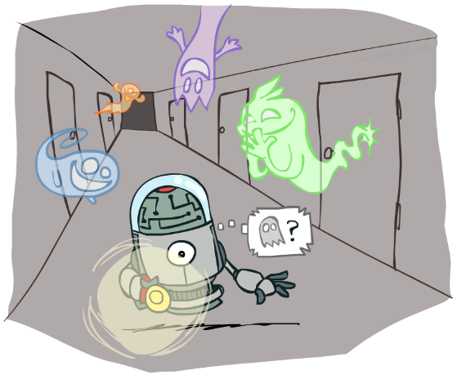

BITS Pilani
Pilani Campus
(some slides adapted from Stuart http://aima.cs.berkeley.edu/)
DSE CL 557 - Artificial and Computational Intelligence
#14. Reasoning over time – Hidden Markov Model
Sunday, January 3, 2021
Dr. Saikishor Jangiti

Slide 2
Today
Reasoning over time
Time and Uncertainty
Inference in temporal models
Overview of HMM
Reference: Chapter 15.1 to 15.3 from AI: A modern approach (Russell, Norvig)

Slide 3
Probabilistic reasoning over time
... means to keep track of the current state of
a process (temperature controller, other controllers)
an agent with respect to the world (localisation of a robot in some “world”)
in order to make predictions or to simply understand what might have caused this current state.

Slide 4
Probabilistic reasoning over time
This involves both
a transition model (how the state is assumed to change)
a sensor model (how observations / percepts are related to the world state).
Previously:
the focus was on what was possible to happen (e.g., search), now it is on what is likely / unlikely to happen
the focus was on static worlds (Bayesian networks), now we look at dynamic processes where everything (state AND observations) depend on time.

Slide 5
Three classes of approaches
Hidden Markov models
Kalman filters
Dynamic Bayesian networks (cover actually the other two as special cases)

Slide 6
Reasoning over time
With
Xt the current state description at time t
Et the evidence obtained at time t
we can describe a state transition model and a sensor model that we can use to model a time step sequence - a chain of states and sensor readings according to discrete time steps - so that we can understand the ongoing process.

Slide 7
Reasoning over time
We assume to start out in X0, but evidence will only arrive after the first state transition is made: E1 is then the first piece of evidence to be plugged into the chain.
The “general” transition model would then specify
ℙ( Xt | X0:t-1)
... this would mean we need full joint distributions over all time steps... or not?

Slide 8
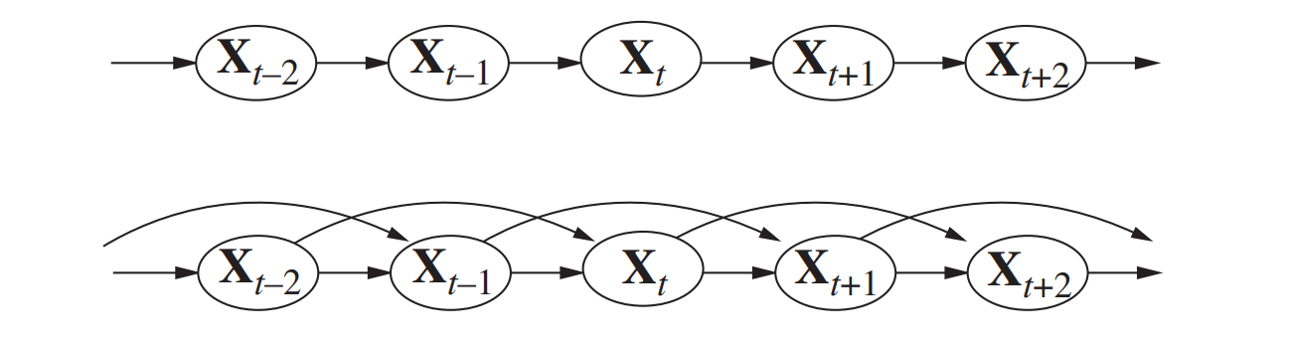
The Markov assumption
A process is Markov (i.e., complies with the Markov assumption), when any given state Xt depends only on a finite and fixed number of previous states.

Slide 9
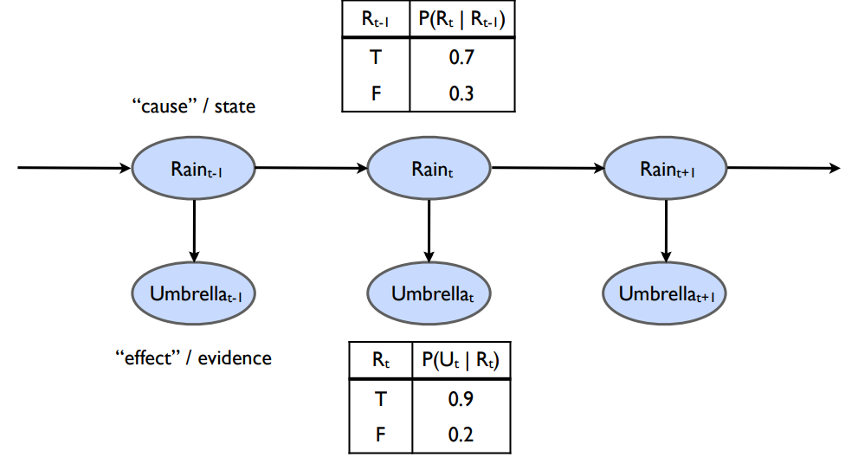
A first-order Markov chain as Bayesian network

Slide 10
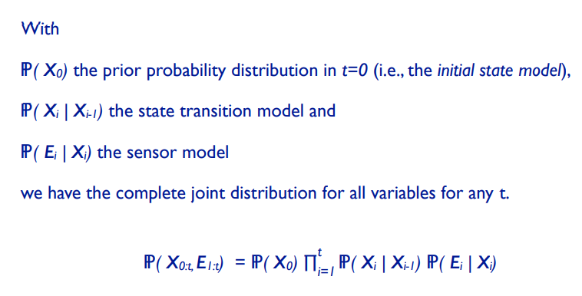
Inference for any t

Slide 11

Reasoning over Time or Space
Often, we want to reason about a sequence of observations
Speech recognition
Robot localization
User attention
Medical monitoring
Need to introduce time (or space) into our models

Slide 12


Markov Models
Value of X at a given time is called the state
Parameters: called transition probabilities or dynamics, specify how the state evolves over time (also, initial state probabilities)
Stationarity assumption: transition probabilities the same at all times
Same as MDP transition model, but no choice of action
A (growable) BN: We can always use generic BN reasoning on it if we truncate the chain at a fixed length
X₁
X₂
X₃
X₄

Slide 13

Markov Assumption: Conditional Independence
Basic conditional independence:
Past and future independent given the present
Each time step only depends on the previous
This is called the (first order) Markov property

Slide 14
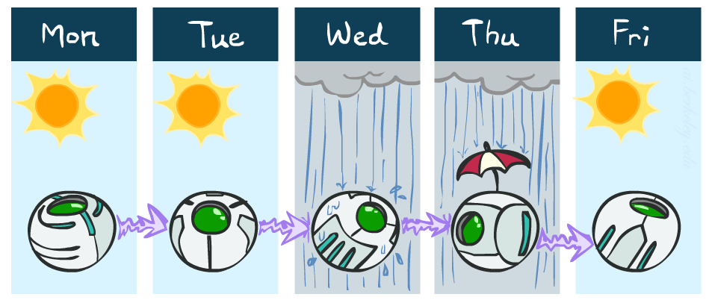
Example Markov Chain: Weather
States: X = {rain, sun}
Initial distribution: 1.0 sun
CPT P(X_{t} | X_{t-1}):
Two new ways of representing the same CPT
X_{t-1} | X_{t} | P(X_{t}|X_{t-1})
sun | sun | 0.9
sun | rain | 0.1
rain | sun | 0.3
rain | rain | 0.7
0.9
0.3
0.9
rain
sun
sun
sun
0.1
0.3
rain
rain
0.7
0.7
0.1

Slide 15
Example Markov Chain: Weather
0.9
0.3
Initial distribution: 1.0 sun
What is the probability distribution after one step?
rain
sun
0.7
0.1

Slide 16
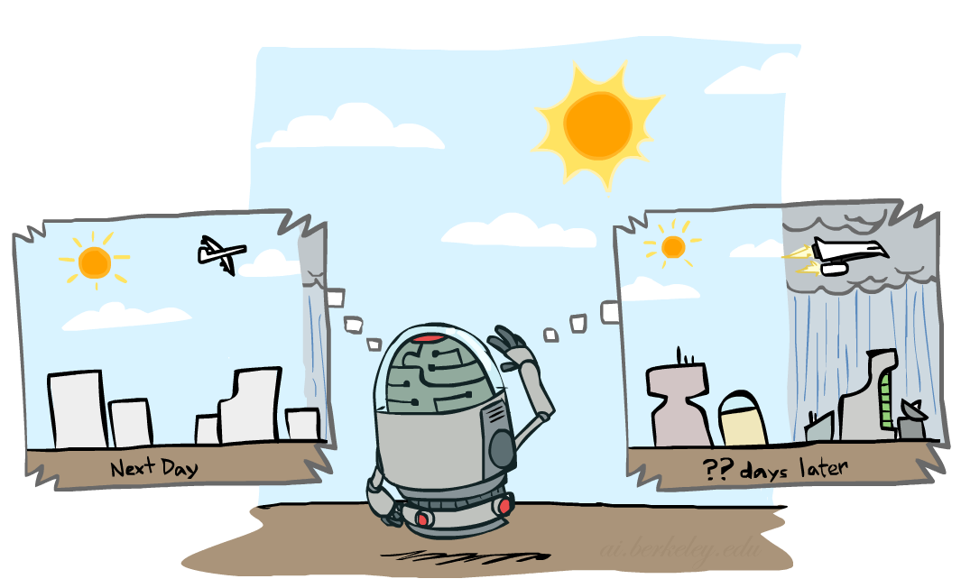

Mini-Forward Algorithm
Question: What’s P(X) on some day t?
X₁
X₂
X₃
X₄
Forward simulation

Slide 17
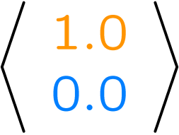
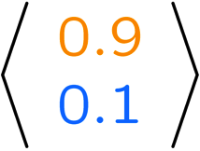
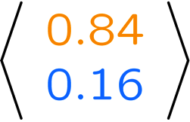
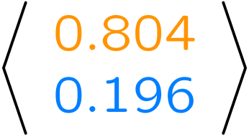
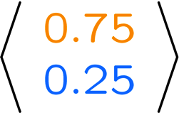
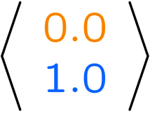
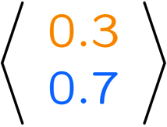
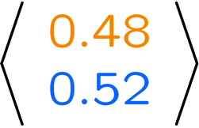
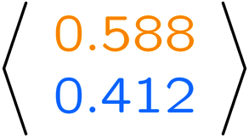
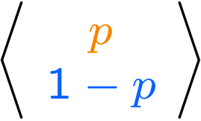
Example Run of Mini-Forward Algorithm
From initial observation of sun
From initial observation of rain
From yet another initial distribution P(X₁):
P(X₁)
P(X₂)
P(X₃)
P(X₄)
P(X∞)
P(X₁)
P(X₂)
P(X₃)
P(X₄)
P(X∞)
…
P(X₁)
P(X∞)
[Demo: L13D1,2,3]

Slide 18

Stationary Distributions
For most chains:
Influence of the initial distribution gets less and less over time.
The distribution we end up in is independent of the initial distribution
Stationary distribution:
The distribution we end up with is called the stationary distribution of the chain
It satisfies

Slide 19

Example: Stationary Distributions
Question: What’s P(X) at time t = infinity?
X₁
X₂
X₃
X₄
X_{t-1} | X_{t} | P(X_{t}|X_{t-1})
sun | sun | 0.9
sun | rain | 0.1
rain | sun | 0.3
rain | rain | 0.7
Also:

Slide 20

Application of Stationary Distribution: Web Link Analysis
PageRank over a web graph
Each web page is a possible value of a state
Initial distribution: uniform over pages
Transitions:
With prob. c, uniform jump to a
random page (dotted lines, not all shown)
With prob. 1-c, follow a random
outlink (solid lines)
Stationary distribution
Will spend more time on highly reachable pages
E.g. many ways to get to the Acrobat Reader download page
Somewhat robust to link spam.
Google 1.0 returned the set of pages containing all your keywords in decreasing rank, now all search engines use link analysis along with many other factors (rank actually getting less important over time)
Notes:
Before: most search engines were merely based on how well a page matches your search words.
Note: currently dominated by clickstreams

Slide 21

Hidden Markov Models

Slide 22
Why Hidden, Markov Model?
The reason it is called a Hidden Markov Model is because we are constructing an inference model based on the assumptions of a Markov process.
The Markov process assumption is simply that the “future is independent of the past given the present”.
In other words, assuming we know our present state, we do not need any other historical information to predict the future state.

Slide 23
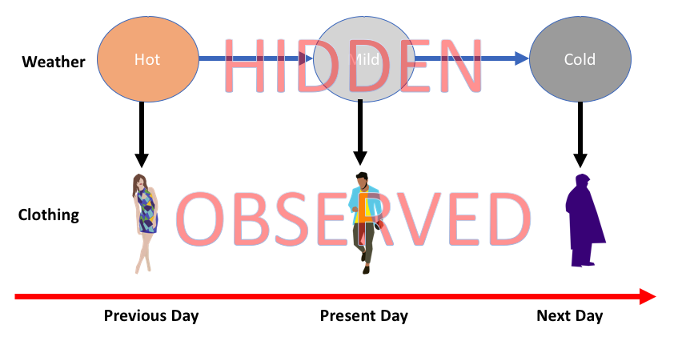
Why Hidden, Markov Model?

Slide 24
Hidden Markov Models
Markov chains not so useful for most agents
Need observations to update your beliefs
Hidden Markov models (HMMs)
Underlying Markov chain over states X
You observe outputs (effects) at each time step
X₁
X₂
X₃
X₄
X₅
E₁
E₂
E₃
E₄
E₅

Slide 25


Example: Weather HMM
Rain_{t-1}
Rain_{t}
Rain_{t+1}
Umbrella_{t-1}
Umbrella_{t}
Umbrella_{t+1}
An HMM is defined by:
Initial distribution:
Transitions:
Emissions:
R_{t} | U_{t} | P(U_{t}|R_{t})
+r | +u | 0.9
+r | -u | 0.1
-r | +u | 0.2
-r | -u | 0.8
R_{t-1} | R_{t} | P(R_{t}|R_{t-1})
+r | +r | 0.7
+r | -r | 0.3
-r | +r | 0.3
-r | -r | 0.7
Notes:
demo

Slide 26


Example: Ghostbusters HMM
P(X₁) = uniform
P(X|X’) = usually move clockwise, but sometimes move in a random direction or stay in place
P(R_{ij}|X) = same sensor model as before: red means close, green means far away.
1/9
1/9
1/9
1/9
1/9
1/9
1/9
1/9
1/9
P(X₁)
1/6
1/6
1/2
0
1/6
0
X₁
X₂
X₃
X₄
0
0
0
X₅
P(X|X’=<1,2>)
R_{i,j}
R_{i,j}
R_{i,j}
R_{i,j}
Notes:
Dan has some demo for this.

Slide 27
Conditional Independence
HMMs have two important independence properties:
Markov hidden process: future depends on past via the present
Current observation independent of all else given current state
Does this mean that evidence variables are guaranteed to be independent?
[No, they tend to correlated by the hidden state]
X₁
X₂
X₃
X₄
X₅
E₁
E₂
E₃
E₄
E₅

Slide 28
Real HMM Examples
Robot tracking:
Observations are range readings (continuous)
States are positions on a map (continuous)
Speech recognition HMMs:
Observations are acoustic signals (continuous valued)
States are specific positions in specific words (so, tens of thousands)
Machine translation HMMs:
Observations are words (tens of thousands)
States are translation options

Slide 29
Filtering / Monitoring
Filtering, or monitoring, is the task of tracking the distribution B_{t}(X) = P_{t}(X_{t} | e₁, …, e_{t}) (the belief state) over time
We start with B₁(X) in an initial setting, usually uniform
As time passes, or we get observations, we update B(X)
The Kalman filter was invented in the 60’s and first implemented as a method of trajectory estimation for the Apollo program
Notes:
Dan has some demo for this

Slide 30
Thank you for your Attention
Any more queries

